Slide 1
Book recommender system using KNN
By – Aryaman Kalia
Vasu verma
Rajneesh verma

Slide 2
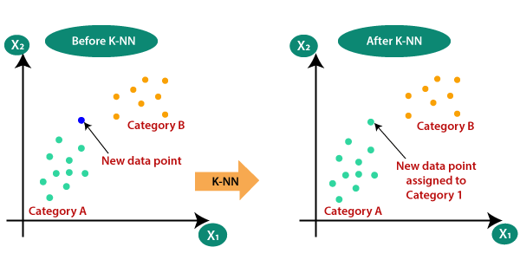

Slide 3
